Slide 1
MULTIPLE LINEAR REGRESSION
Lecture 09

Slide 2
In the previous topic, we have learned about Simple Linear Regression, where a single Independent/Predictor(X) variable is used to model the response variable (Y). But there may be various cases in which the response variable is affected by more than one predictor variable; for such cases, the Multiple Linear Regression algorithm is used.
Moreover, Multiple Linear Regression is an extension of Simple Linear regression as it takes more than one predictor variable to predict the response variable. We can define it as:

Slide 3
For MLR, the dependent or target variable(Y) must be the continuous/real, but the predictor or independent variable may be of continuous or categorical form.
Each feature variable must model the linear relationship with the dependent variable.
MLR tries to fit a regression line through a multidimensional space of data-points.

Slide 4

The Multiple Regression Model
Regression model for k independent variables:
Multiple Regression allows us to:
Use several variables at once to explain the variation in a continuous dependent variable.
Isolate the unique effect of one variable on the continuous dependent variable while taking into consideration that other variables are affecting it too.
Write a mathematical equation that tells us the overall effects of several variables together and the unique effects of each on a continuous dependent variable.
Control for other variables to demonstrate whether bivariate relationships are spurious

Slide 5
MLR equation:
In Multiple Linear Regression, the target variable(Y) is a linear combination of multiple predictor variables x₁, x₂, x₃, ...,x_{n}. Since it is an enhancement of Simple Linear Regression, so the same is applied for the multiple linear regression equation, the equation becomes:
Where,
Y= Output/Response variable
b₀, b₁, b₂, b₃ , b_{n}....= Coefficients of the model.
x₁, x₂, x₃, x₄,...= Various Independent/feature variable

Slide 6
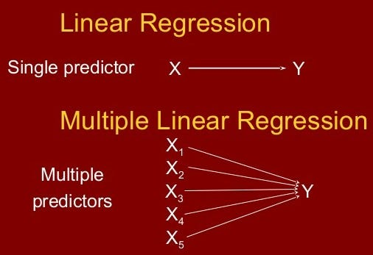

Slide 7
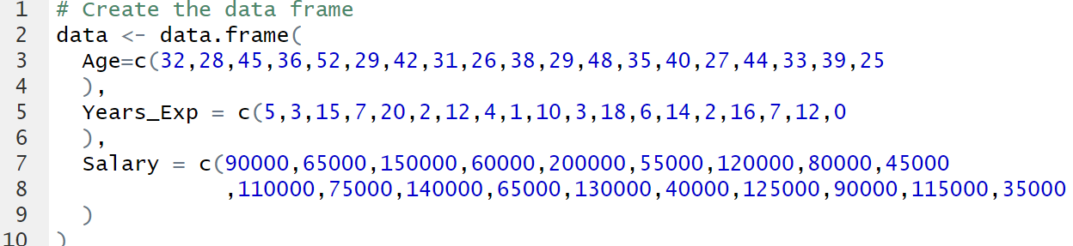
R Code
# Create the data frame

Slide 8
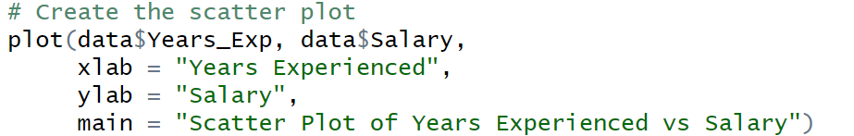

Slide 9
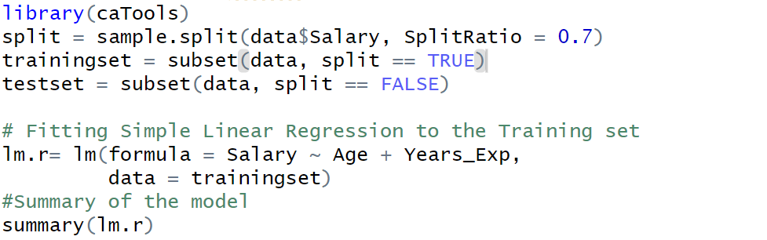

Slide 10
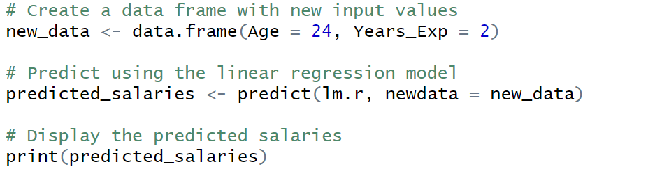

Slide 11
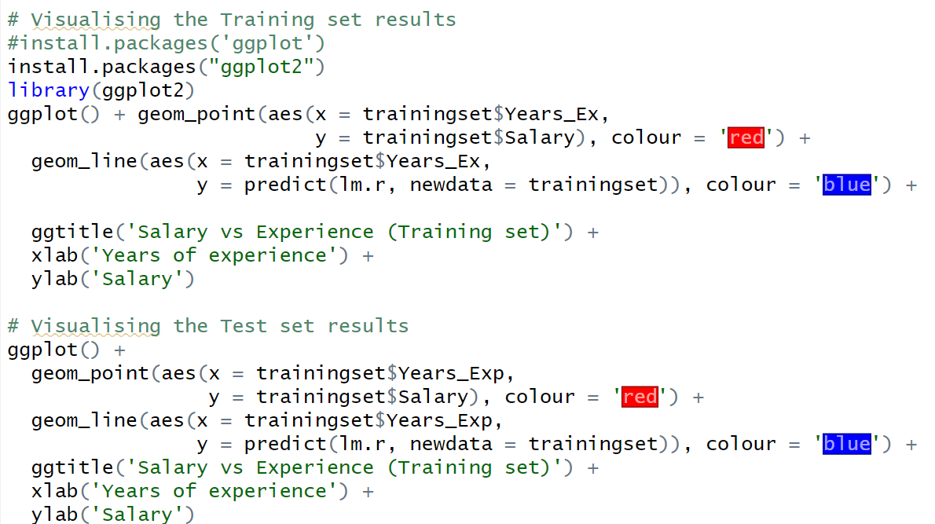

Slide 12
